Slide 1
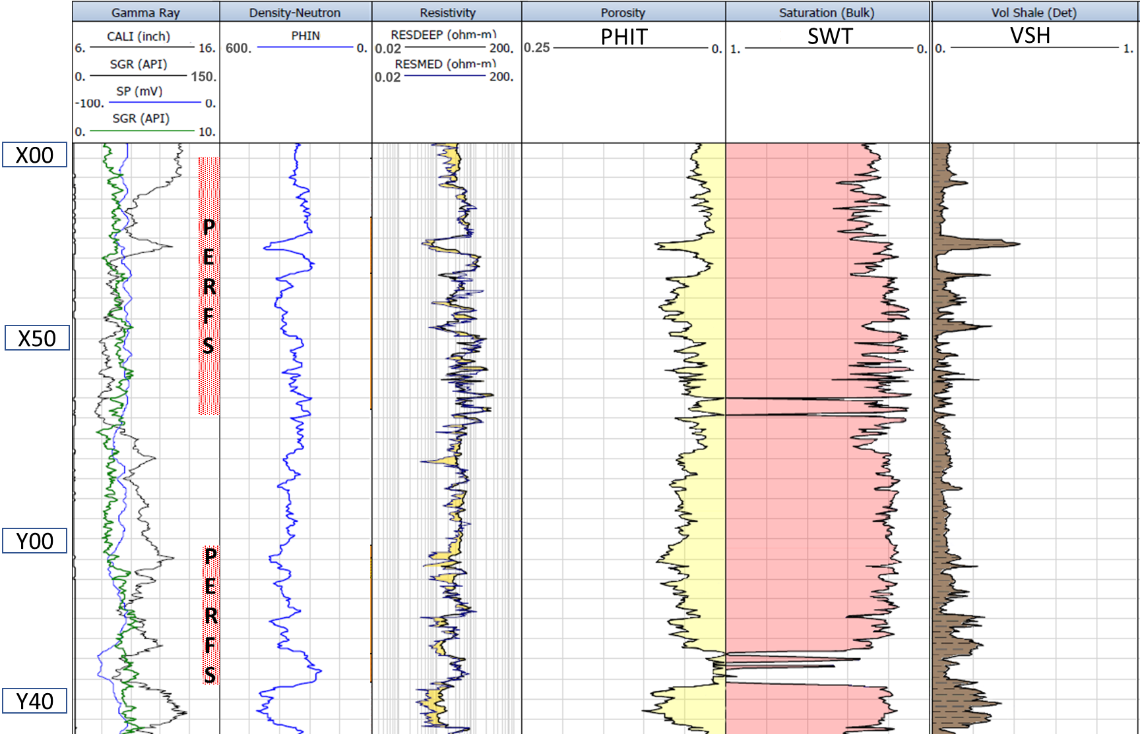

Slide 2
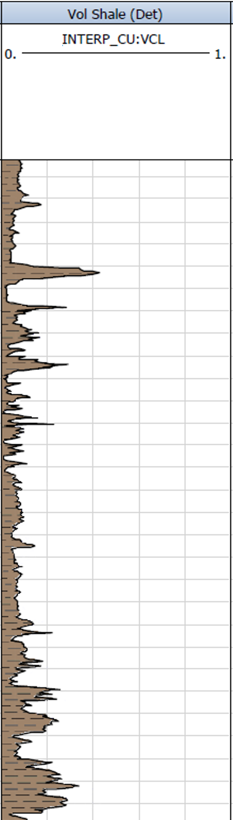
PHIT
SWT
VSH
X00
PERFS
X50
Y00
PERFS
Y40

